Slide 1
demo
demo
demo
demo
a&n

Slide 2




Adam
Steve
Adam has a crush on Steve
Adam is unsure whether Steve likes him back

Slide 3


this is gone.

Slide 4
Not taking advantage of the internet
21st century education

Slide 5
2.1 bn

Slide 6
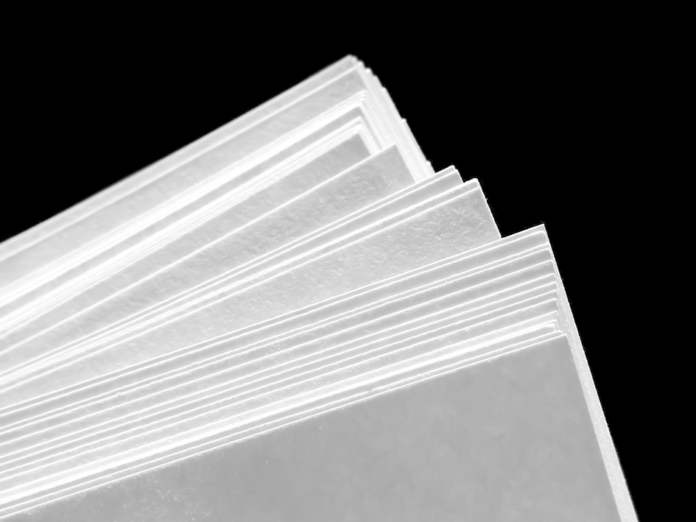
40%

Slide 7
39.2%

Slide 8
simple
functional
versatile

Slide 9
what’s to like?

Slide 10
Putin
Sign up today! It’s totally free
itookcrimeahue
Jong Un has joined the room
“Russio iz bester than Murica”
Jong Un

Slide 11
simple enough

Slide 12
enough

